Slide 1
HOW NEWS APPEARS ON SOCIAL MEDIA
Name- Sudarshan Dasarathy Stevens CWID- #10453162

Slide 2
Executive Summary
The main aim of this project is to find out the role that social media plays to spread out the information, because people nowadays are very much involved in social media than the real world.
The 3 main questions that we are going to address is:-
To determine what kind of news is being fed to the people?
Which social media site is used most ?
What type of trends appear most on each social media platform that influence and shape what users talk about and read?

Slide 3
Key Attributes
This data set consists data from social media handles such as :- Twitter ,newsAPI, Google Trending Topics, and six popular domain (news, worldnews, upliftingnews, sports, politics, television).
Twitter: trending topic, date trending, sentiment analysis scores, most common word associated with the trend, most common pairs of words associated with the trend.
News: headlines (collected from BBC News, USA Today, and the Washington Post), date the article was posted.
Google Trending Topics: trending topic, date trending.
Subreddits: post title, time, date, score (upvotes - downvotes), number of comments.

Slide 4
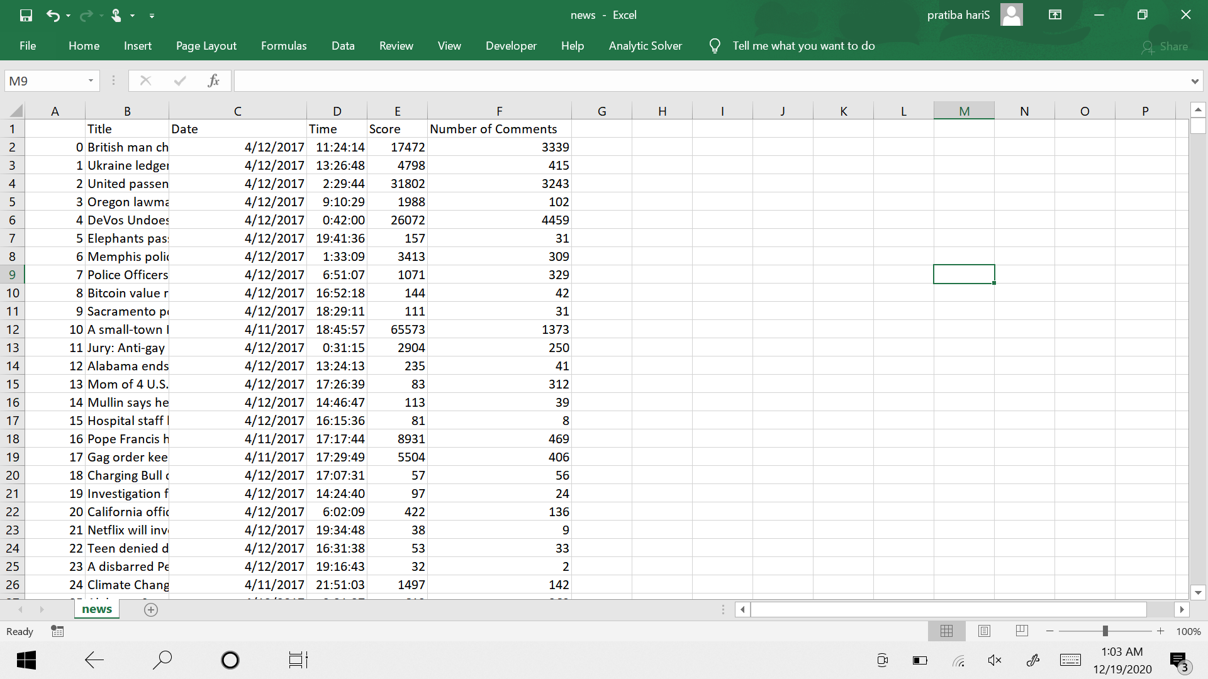
DATASET
It has 6 columns and 1201 rows of different news titles from 2017
The data contains such attributes as title, data,score and number of comments.

Slide 5
Data Preparation
The most blatant issues were missing and empty cells and overall format issues generated by the body text column which contained the entirety of each article. This column was subsequently the first to be removed to alleviate many of these issue
Redundant data which would not contribute to the overall analysis was removed . This resulted in minimizing the number of outliers being formed after analysis.
We used basic Excel trimmings to normalize the dataset.

Slide 6
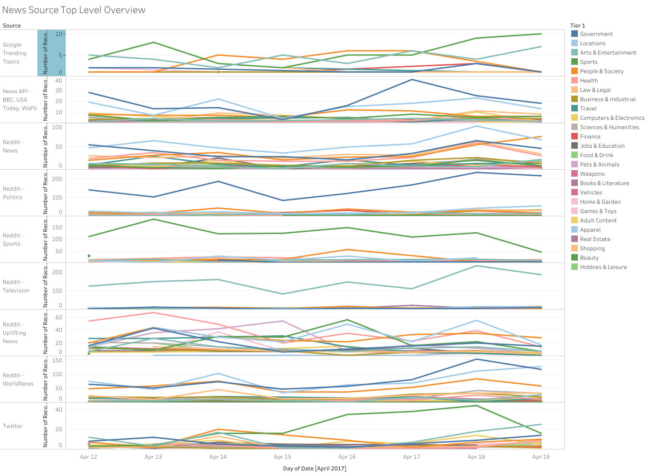
Dashboard

Slide 7
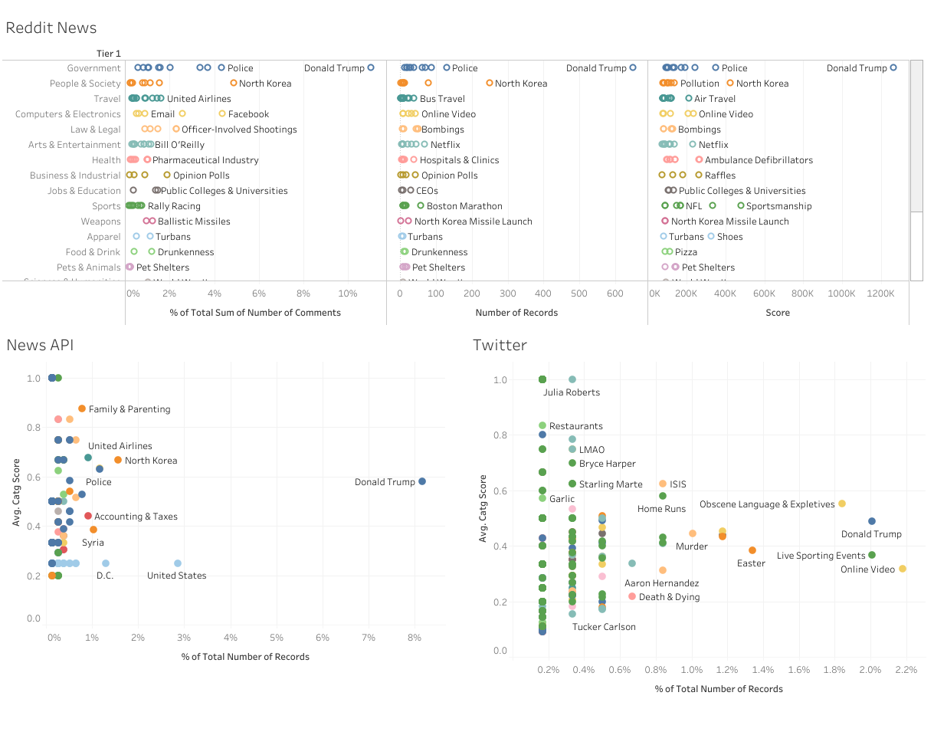
Comparison of News platforms

Slide 8
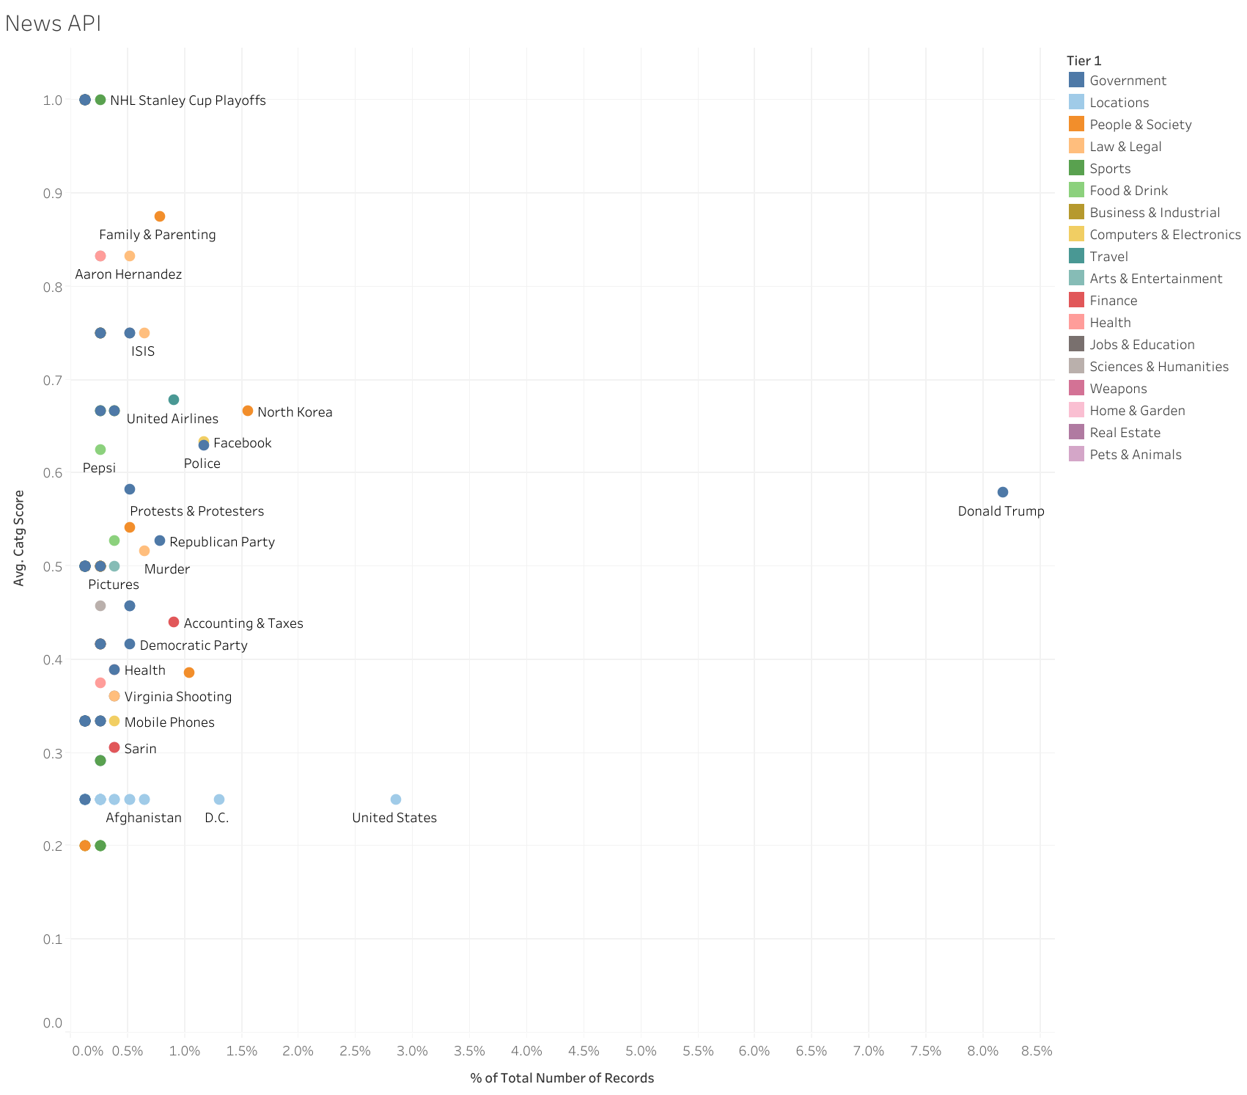
NEWS API

Slide 9
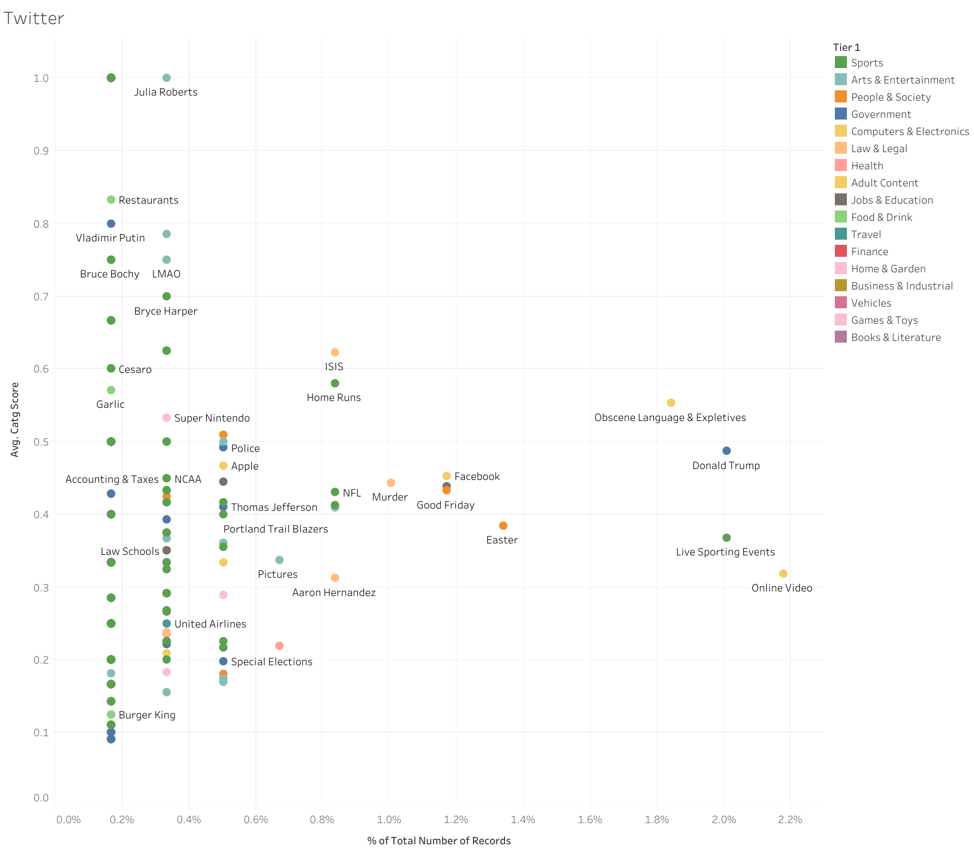
TWITTER

Slide 10
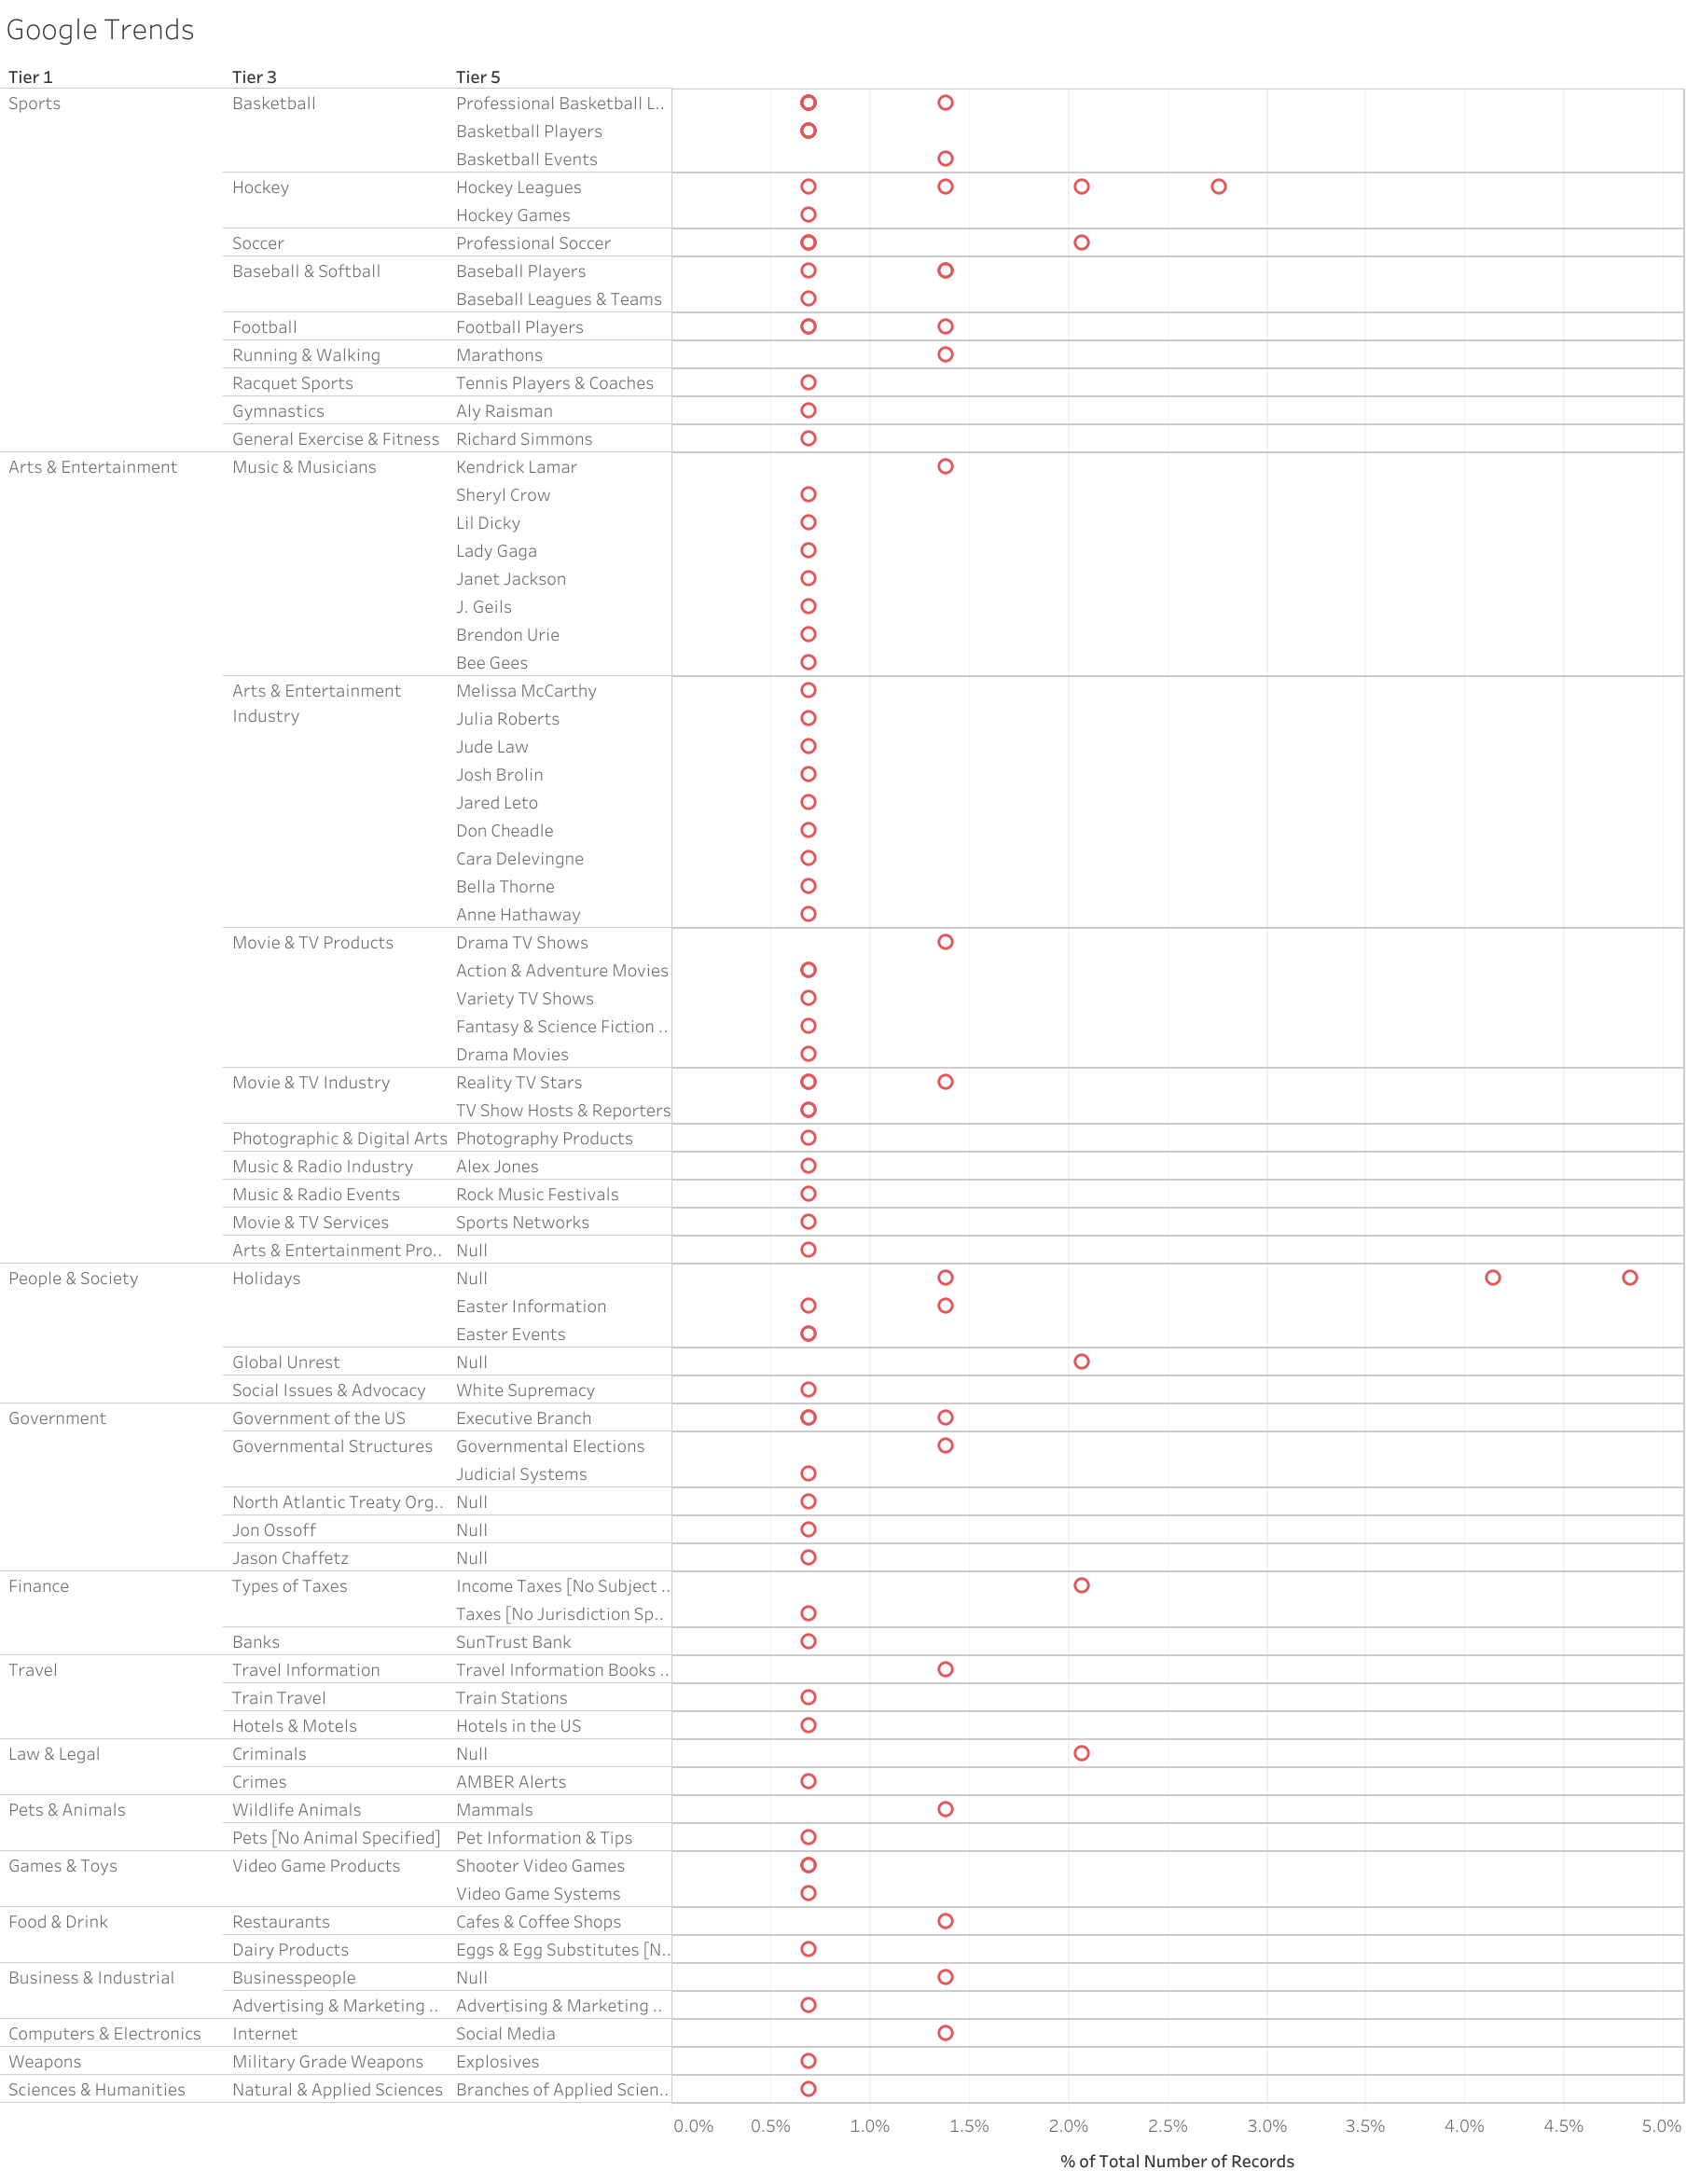
GOOGLE TRENDS

Slide 11
Conclusion
Using the analysis we can find that
The most used Social Media Website is Twitter
The News that were related to politics,Sports events, entrepreneurs were the most trending.
News API/Reddit News- Donald Trump
Google – People & the society
Twitter- Online Video and sporting events

Slide 12
Reference
Golbeck, Jennifer.(2013). Analyzing the social web. ISBN: 0124055311.
Hanneman, R. A., & Riddle, M. (2005). Introduction to social network methods.
www.kaggle.com
https://techterms.com/definition/matrix
https://www.kaggle.com/socialmedianews/how-news-appears-on-social-media?select=sports.csv
https://www.sciencedirect.com/science/article/pii/S2468232216000123
https://dataaspirant.wordpress.com/2014/09/19/supervised-and-unsupervised-learning

